Slide 1

The Power of 900 Seconds
Predicting the outcome of League of Legends Esports matches at the 15th minute.

Slide 2
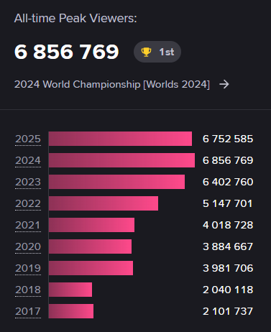
Why?
It’s a very popular game.
It’s a game I have played and watched a lot in the last few years.
Making predictions is a core, fun aspect of watching sports/esports.
A model can uncover some interesting matches…
Source: escharts.com/games/lol

Slide 3
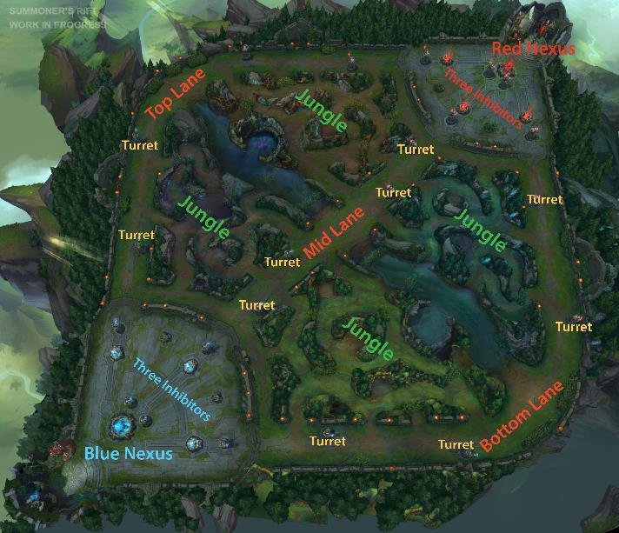
What is league of legends?
Gold is earned from killing minions and enemy players.
Gold can be used to buy items.
Items make a character stronger.
More gold = Stronger characters.
Stronger characters = more fights won.
More fights won = Push further into enemy base.
Push further into enemy base = win the game.

Slide 4
What’s being explored?
Does a lead at 15 minutes translate into a win?
Average game duration was 32:51
Which metrics influence win probability the most?
Finding interesting matches…
Data obtained from Oracle’s Elixir.
Using 2025 esports matches from the 4 3 major leagues + Worlds and MSI.
Using a range of models and comparing performance.
Logistic Regression
Random Forest
LightGBM

Slide 5
Modelling
Base Model
Improved Model
1238 matches.
Features:
First Kill
First Dragon
Void Grub Count (per team)
Gold, XP, CS Difference @ 15
Kills @ 15 (per team)
Turret Plate Count (per team)
Region (per team)
Everything in the base model plus:
Region Strength (per team)
Win Rate of Last 10 Matches (per team)

Slide 6
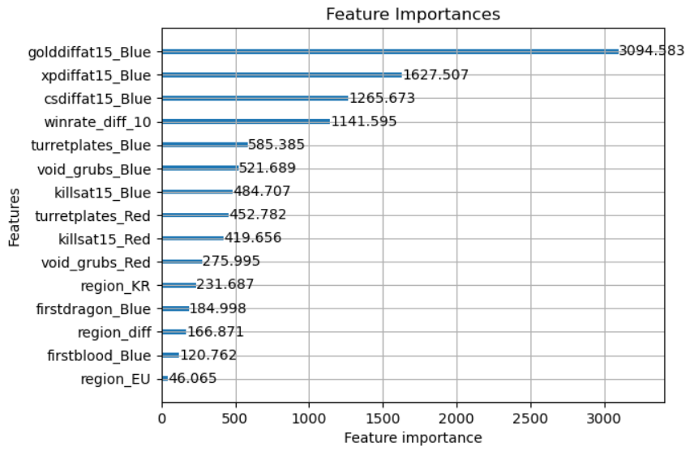
Modelling Part 2
LightGBM narrowly beat the other models. Initial accuracy was around 66%.
Accuracy was increased to 70% after fine-tuning. This wasn’t bad given the nature of the data.
Overfitting was reduced from 20-25% to 2-10%.

Slide 7
My Predictions
Rules
Results
Rules for blue win:
>1000 gold diff @ 15.
>500 gold diff @ 15 and first dragon.
>0 gold diff @ 15, first dragon, and more void grubs than opponent.
<0 gold diff @ 15, first dragon, and 3 or more void grubs over opponent.
68%

Slide 8
Interesting Matches
Exploring statistically unlikely outcomes

Slide 9

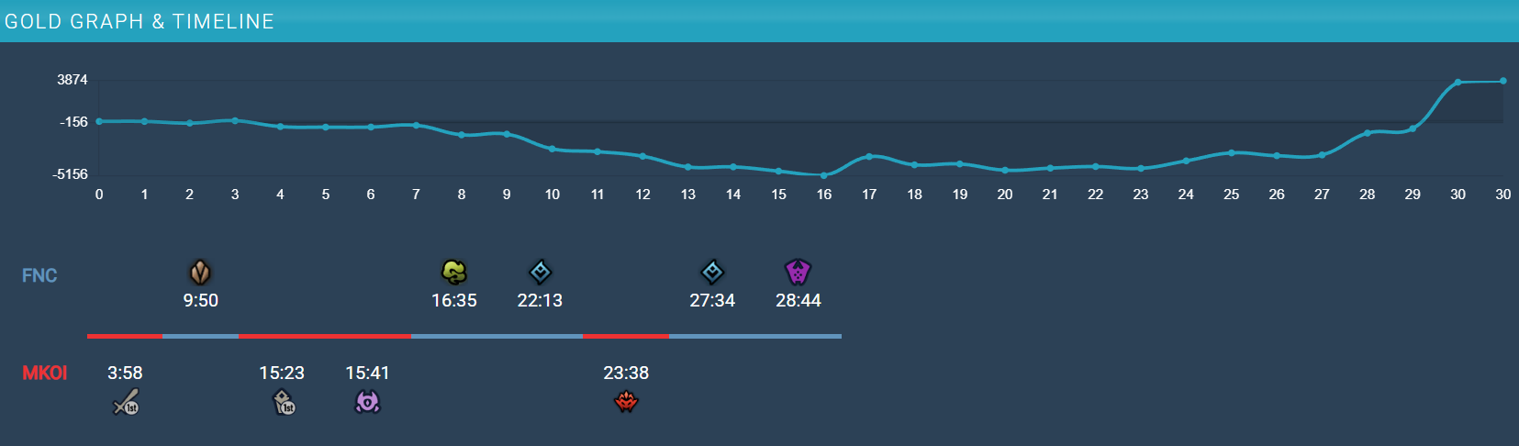
Example #1
Largest gold difference for a win that was labelled as a loss.
Win probability was only 11%.
Source: gol.gg

Slide 10
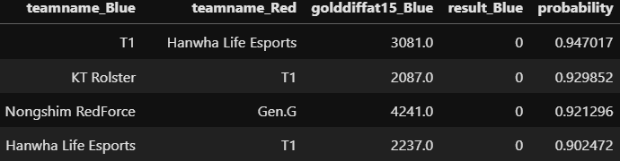
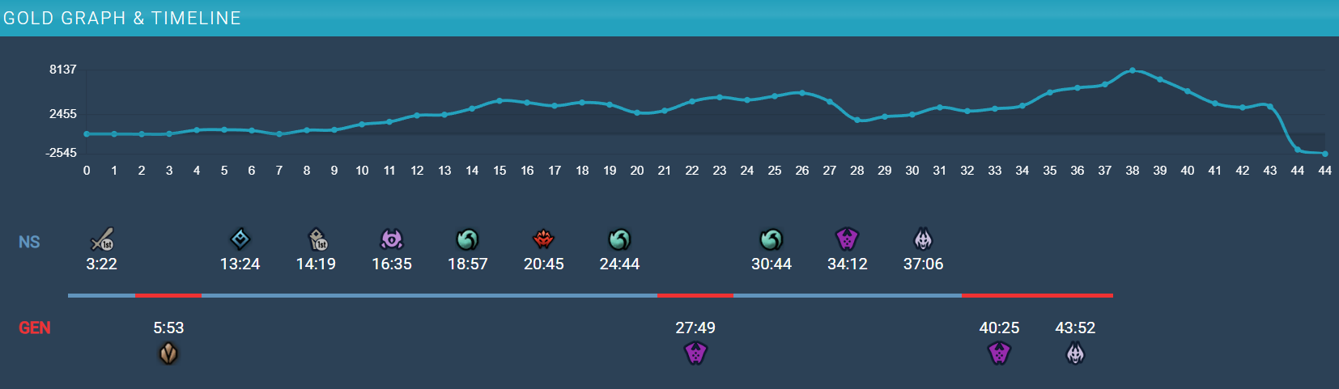
example #2
Largest win probabilities that ended in a loss.
14 out of top 20 matches in this list involved a Korean team.
Source: gol.gg

Slide 11
Thank you for your attention!

